Slide 1
VR for Social Simulations
Andrew Tucker, Esther Ng, Ethan Wagner, Hunter Williams, Minh Nguyen
Notes:
Let em cook

Slide 2
Introduction
Goal: Use virtual reality (VR) as a tool for users with social development disorders and researchers to learn from.
Notes:
(Minh)
The project aims to implement virtual reality (VR) as a tool for users to practice social interactions and for researchers to collect data to analyze. The target user group are youth with social development disorders. By using VR, users can practice social interactions in a safe and predictable environment that provides insights to researchers.

Slide 3

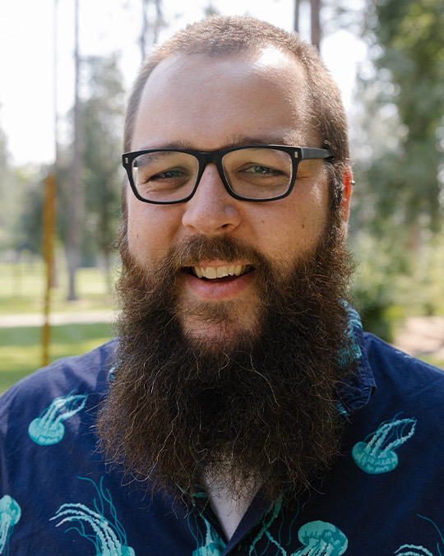
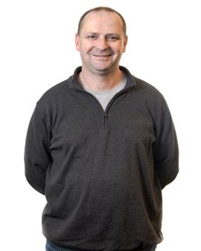
Client & Faculty Mentors
Dr. Vicky Tsang
Scott Griffith
Dr. Pete Tucker
Associate Professor of Occupational Therapy
Assistant Professor of Computer Science
Professor of Computer Science
Client
Client & Faculty Mentor
Faculty Mentor
Notes:
(Minh)
Dr. Vicky Tsang is the primary client of our project. She is the researcher interested in studying the data resulting from the social simulations. Dr. Tsang’s past research has been focused on pediatric occupational therapy and using technology to learn more about development. Using VR is a next step in using newer technology in these fields.
Scott Griffith is collaborating with Dr. Tsang to work with student developers in this project and has acted as a mentor to our project, as well as Dr. Pete Tucker who provided us with additional guidance.

Slide 4
Client Requirements
Our client has 3 main research questions:
What kind of social interactive data can be captured using the eye, face, and hand tracking functions of the VR headset?
How can the VR headset be used to develop an interactive VR architecture with a temporal dimension?
Can we use the existing technological functions of a 3D camera to create simulated social scenarios in VR as an intervention program?
Notes:
(Esther) Our client has 3 main questions of interest in this project. First is the question on how the data collected using the VR headset’s built in tracking functions can be used. This includes eye tracking, face tracking, and hand tracking functions. Second, how can we use the VR headset to develop an interactive VR architecture with a temporal dimension? Meaning, we want the structure to interact with users in both a spatial and time dimension. This includes allowing users to walk through the simulation and make choices, as well as organizing data collected in a dynamic way. Third, can we use a 3D camera to create these social scenarios for the target user group as an intervention program? The long-term goal is to create a realistic simulation that helps users practice social interactions.
We built our project with these questions in mind.

Slide 5
01
About Our Project
Notes:
(Ethan)
The VR Project is a project started in the Spring 2024 semester of Software Engineering CS472,
in which we are aiming to develop a program that can be used to practice social interactions.
While the main group of users will be children with social disorders, anyone can be a potential user.
This is intended to be continued past Spring 2024, with other student developers taking on the project where we will leave it off.

Slide 6
Why is our project interesting?
Use of VR in a research project
New experience unlike other courses
Visual programming for Unreal Engine
Neural network to identify faces
A Simlation to Practice Social Scenarios
Notes:
(Ethan)
Our project aims to recreate social scenarios in virtual reality (VR) for youth with neurodevelopmental or social disorders to practice in.
While the main group of users will be children with social disorders, anyone can be a potential user
By using VR, users can practice social interactions in a safe environment that provides insights to researchers.
This is intended to be continued past Spring 2024, with other student developers taking on the project where we will leave it off.
Our project is interesting in multiple aspects.
First, we are using VR in a research project as a tool to gather insight on how we as people socialize
Second, the parameters of this project are more unique compared to past courses, so it pushed us to gain new skills as developers.
Third, although the simulation development is a large part of the programming requirements, we also got to incorporating other aspects such as data science and machine learning, which we will discuss more specifically later in the presentation.

Slide 7


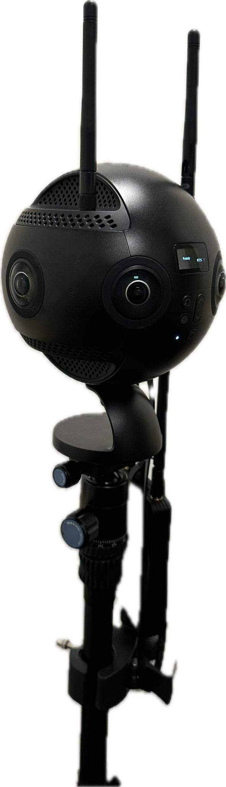
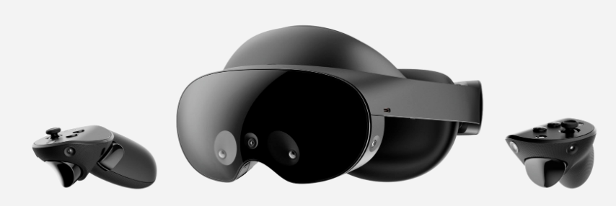
Product Specifications - Hardware
Camera capable of recording 360°
VR headset
equipped with eye and motion tracking technology
Notes:
(Hunter) Our project includes multiple pieces of hardware and programs. We used an Insta360 camera to record in 360 degrees, which works because of multiple lens around the camera that record simultaneously then stitches them together as one video. The camera uses 6 nano SD cards and 1 main SD card to fully store the videos. For the headset, we used a Meta Quest Pro which is currently the newest headset by Meta. The headset includes eye and motion tracking technology, which was essential to our project in collecting and using data from the users.

Slide 8


Product Specifications - Software
Unreal Engine: VR development program.
Android Studio: packaging VR project for Meta Quest Pro
Notes:
(Hunter)
We decided to use Unreal Engine as our VR development program because some team members had brief introductory level experience with Unreal. Android Studio was also used to package the VR project to use on our headset.

Slide 9
Completed Backlog Items
Wrote the script for scenarios
Research and test VR programming tools
Successfully record 360 videos and import them into Unreal
Optimize the videos so it looks as realistic as possible in the headset
Create branching options based on user selection
Started data export from the simulation for analysis
Started a neural network learning model
Notes:
(Esther)
At the start of the project, we came up with a product backlog of items that we wanted to accomplish
First, we wrote a script for initial scenarios we wanted to include. These scenarios took place in the HUB and included interactions like asking someone for directions, swiping into the dining hall, choosing a meal option, and interacting with another student for seating.
Second, we researched different VR tools and after deciding to use Unreal Engine, we looked into various tools such as plug-ins or other programs that would help us with specific goals.
None of us had used a 360 camera prior to this project, so figuring out the correct setting for recording, exporting to the laptop, and then importing into Unreal Engine was a new process to learn
In particular, optimizing the video so that it looks as realistic as possible was a challenge. The lighting, perspective, and rate of motion are all factors that affect a user’s experience, which are things we worked to adjust so that it is user-friendly.
Another goal was to have the simulation progress differently based on choices the user makes. We were able to implement this by creating a branching structure in the game.
We also began developing methods to export data from the simulation for analysis. We started with focusing on eye tracking and were able to construct a data file with x, y, z coordinates of where a user is looking correlating to time. We are close to getting the file to fully export properly but are running into issues with writing the file to a location.
Lastly, we started working on a neural network learning model to provide researchers with specific data regarding what the user looked at.

Slide 10
Unmet Backlog Items
Replacing videos with ones filmed in the HUB
Dynamic data output
Face, hand, body motion tracking
Eye or motion selection for options
Notes:
(Esther)
Replacing videos with ones filmed in the HUB:
Dynamic data output: Our client hopes to have the data presented in a dynamic manner, whether it is creating a replay of the simulation with data overlaid or other methods.
Face, hand, body motion tracking: We primarily focused on eye tracking first, so we were unable to complete analysis for face, hand, and body motion tracking. This is a goal that will be worked on with the next developer group, since this data is valuable in understanding how a user is interacting with the simulation.
Lastly, eye selection for options is another goal for the project that we were unable to meet in time. As we will show you in the demo, we are currently allowing users to make a selection using the hand controls, but ideally, users would be selecting options using eye contact or motion. For example, eventually we want it to be so that if a user makes eye contact with a staff member, then the staff member will begin talking, rather than having them press an option to talk.
Next, Hunter will walk through our simulation and demo it.

Slide 11
02
Demo Walkthrough

Slide 12
Simulation Structure
Start of Sim
In the Hall
Hall Outside of the Room
Room Idle
End of Hall
Convo 1
Start Conversation
Convo 2
Response 1
Response 2
Notes:
(hunter) To understand more about our project, the simulation can be modeled in the diagram above based on the script we wrote. The next scene is different depending on the option the user selects. Really want to highlight:
Each node is a pre recorded video, they are fairly easy to swap out in unreal
Difficulties in finding the sweet spot for video quality too high simulation lags, too low and staring some pretty blurry environments and actors
Each set of arrows representing the options the user has to move through the sim be presented with

Slide 13
Video Demo
Notes:
(Hunter)

Slide 14
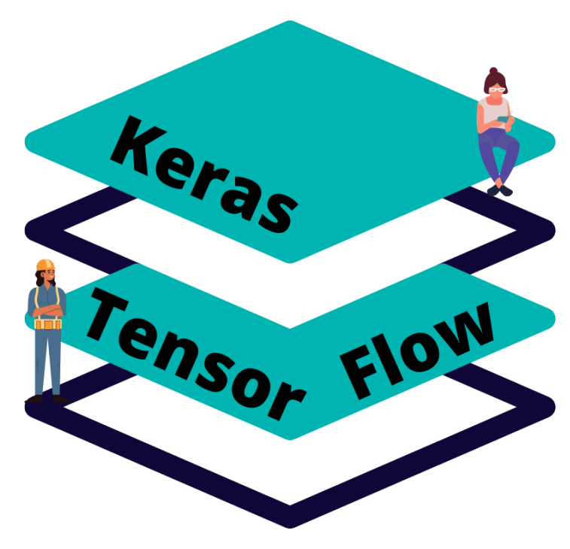
Neural Network Model
Built using Keras and TensorFlow
Interpret data from user (eye contact)
Correctly recognize human faces within images
Images need to be extracted/adjusted for use in the network
Notes:
(Andrew)
Reason for a neural network: identifying correctly and accurately the presence of a face within an image.
Designing a 2D convolutional neural network for image classification.
Finding/correcting the dataset.
Adjusting the structure of the neural network to attempt to increase the accuracy / fighting overfitting.
Raw data extracted is not in image format.
Image manipulation to format to the NN.

Slide 15
03
Future Work
Notes:
(Andrew)

Slide 16
Future Work
Audio Input
Body Motion
Take voice as an input from users
Track body and hand motions
Data Analysis & Visualization
Option Selection
Present the data in a dynamic manner
Options proceed as users move
Notes:
(Andrew)
Since this project will be continued by future developers, there are multiple goal that will be implemented next.
Audio input: take voice as an input from users, as well as record any vocal statements or selections. This will allow researchers to analyze behaviors as it relates to voice.
Body motion: track body and hand motions to provide researchers with more insight on how users are moving within the simulation.
Data analysis and visualization: Applying the neural network to the simulation will allow for identification of whether users are looking at a face or an object and for how long. Additionally, presenting the data in a dynamic way, such as overlaying tracked data over a replay of the simulation, will allow researchers and users to better view the analytics of what happened within the simulation.
Option selection: the current mechanism of selection, which is using the hand controls to manually push an option, is not the most realistic. As such, future development can include option selection that happens as the user walks towards a certain area, for example, or makes long enough eye contact with a person in the simulation.

Slide 17
04
Post Mortem
Notes:
(Ethan)

Slide 18
What went well?
Successfully built the project despite lack of familiarity
Thorough Documentation
Image Processing Model
A Foundation and Direction for Future Development
Customizable Simulation
Notes:
(Ethan)
Successfully created a highly customizable simulation
Got Real Experience in Really Powerful Tools
With all the power comes the complexities as we really only scratched the surface
Anothet challenge we faced was our lack of familiarity with VR. Only a few of us have hada brief experience with VR and Unreal, while the rest of us had no experience at all. Building the project from ground up while learning how to use all the tools we had was challenging, but we were able to successfully build the project foundation. THIS LEADING TO MANY learning opportunities having to struggle through
Since our project will be continued by other students in the future, we made sure to extensively document all the software and hardware we used, as well as various processes and procedures to save future developers some time. We are proud of the foundations we have put in place having a solid proof of concept and are extremely excited to see where the future takes this project.
DevelopimThe Let's Find Out Mentality

Slide 19
What did not go well?
Steep Learning Curve
Hardware Issues
Minimal support with resolving most issues
Notes:
(Minh)
Steep learning curve: Although we were able to build the project, our progress was slower than we would have liked, especially in the beginning. We weren’t able to rely on previous knowledge as much and had to learn how to use all the hardware and programs from the beginning.
Hardware issues: One issue we ran into was that one of the controllers stopped working. We troubleshooted extensively and submitted a support ticket for it, but ended up having to purchase another one. Another thing we discovered later into development was that if we had used something like the Valve Index or the PlaySTation VR headsets instead of the Meta Quest Pro it would have been easier to get the simulation running.
Difficulties with resolving common issues: We ran into some issues specific to using VR for a research project, which isn’t as common as using VR for games. As a result, there weren’t as many accessible resources or answers. One example is our issue with extracting a file with the eye-tracking data. Most applications of eye-tracking for VR is related to building an avatar for a game or other functions within a game. Additionally, extracting a file with that data may be related to privacy concerns as well, according to some sources we’ve looked into. The file structure of the Quest is different from that of the computer we worked on, which made file transfer not straightforward.
As a result, there were only a few resources online that helped us with this issue so it took a bit longer for us to develop a solution.

Slide 20
Thank you!
Notes:
(Esther)

